Slide 1
Linear Equations in Linear Algebra
VECTOR EQUATIONS

Slide 2

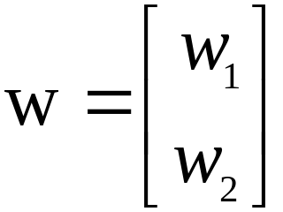
VECTOR EQUATIONS
Vectors in
A matrix with only one column is called a column vector, or simply a vector.
An example of a vector with two entries is
,
where w₁ and w₂ are any real numbers.
The set of all vectors with 2 entries is denoted by (read “r-two”).

Slide 3


VECTOR EQUATIONS
The stands for the real numbers that appear as entries in the vector, and the exponent 2 indicates that each vector contains 2 entries.
Two vectors in are equal if and only if their corresponding entries are equal.
Given two vectors u and v in , their sum is the vector obtained by adding corresponding entries of u and v.
Given a vector u and a real number c, the scalar multiple of u by c is the vector cu obtained by multiplying each entry in u by c.

Slide 4
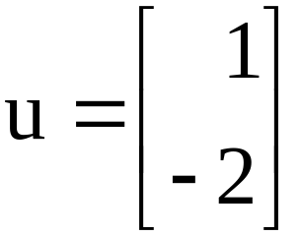
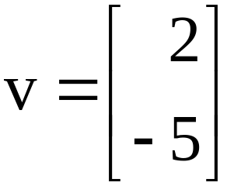


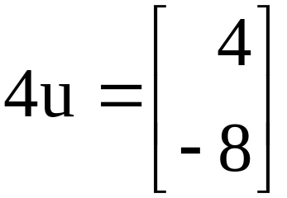
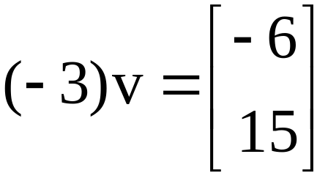
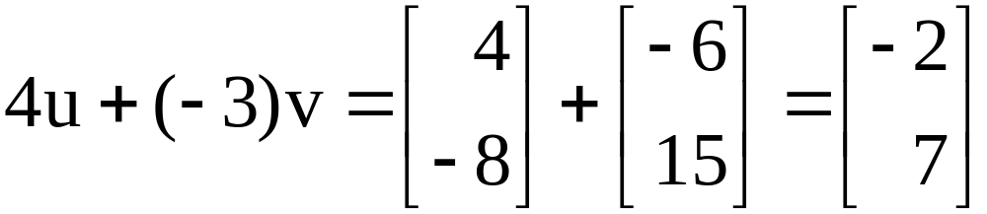
VECTOR EQUATIONS
Example 1: Given and , find
4u, , and .
Solution: , and

Slide 5

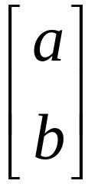
GEOMETRIC DESCRIPTIONS OF
Consider a rectangular coordinate system in the plane. Because each point in the plane is determined by an ordered pair of numbers, we can identify a
geometric point (a, b) with the column vector .
So we may regard as the set of all points in the plane.

Slide 6
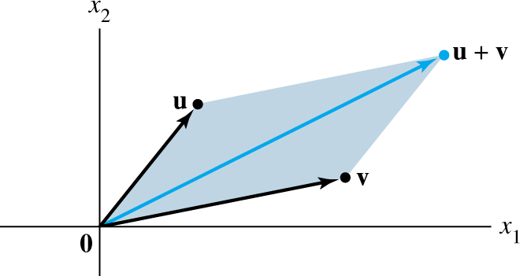
PARALLELOGRAM RULE FOR ADDITION
If u and v in are represented as points in the plane, then corresponds to the fourth vertex of the parallelogram whose other vertices are u, 0, and v. See the figure below.

Slide 7






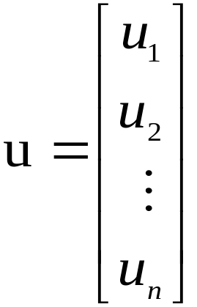
VECTORS IN and
Vectors in are column matrices with three entries.
They are represented geometrically by points in a three-dimensional coordinate space, with arrows from the origin.
If n is a positive integer, (read “r-n”) denotes the collection of all lists (or ordered n-tuples) of n real numbers, usually written as column matrices, such as
.

Slide 8








ALGEBRAIC PROPERTIES OF
The vector whose entries are all zero is called the zero vector and is denoted by 0.
For all u, v, w in and all scalars c and d:
  (i)
  (ii)
  (iii)
  (iv) ,
  where denotes
  (v)
  (vi)

Slide 9


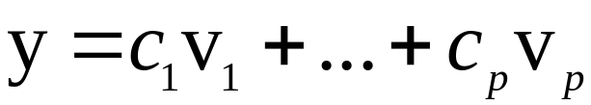
LINEAR COMBINATIONS
    (vii)
    (viii)
Given vectors v₁, v₂, ..., v_{p} in and given scalars c₁, c₂, ..., c_{p}, the vector y defined by
is called a linear combination of v₁, …, v_{p} with weights c₁, …, c_{p}.
The weights in a linear combination can be any real numbers, including zero.

Slide 10
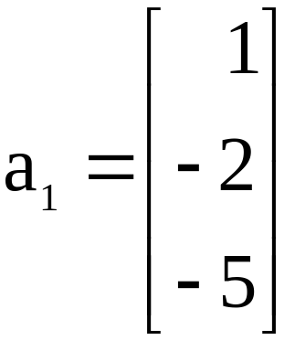
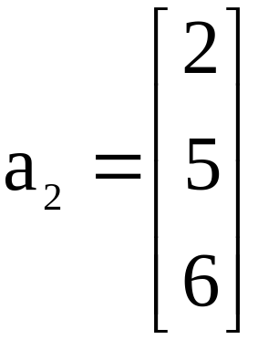
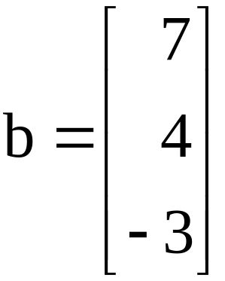
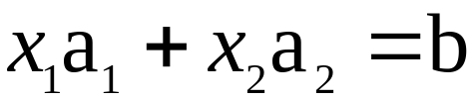
LINEAR COMBINATIONS
Example 2: Let , and .
Determine whether b can be generated (or written) as a linear combination of a₁ and a₂. That is, determine whether weights x₁ and x₂ exist such that
----(1)
If vector equation (1) has a solution, find it.

Slide 11
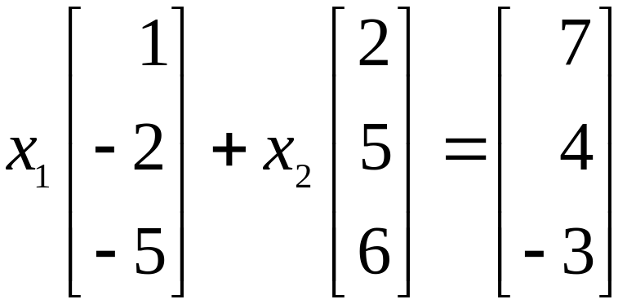
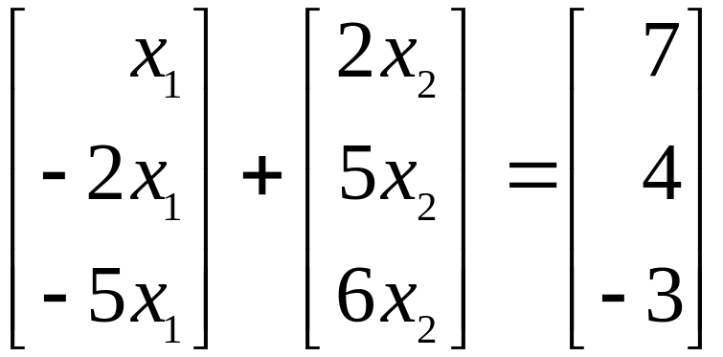
LINEAR COMBINATIONS
Solution: Use the definitions of scalar multiplication and vector addition to rewrite the vector equation
,
which is same as
a₁
a₂
a₃

Slide 12
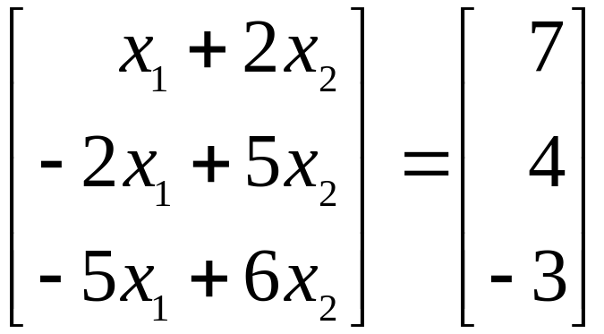
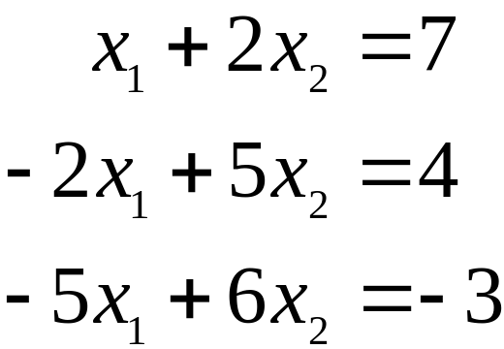
LINEAR COMBINATIONS
and
. ----(2)
The vectors on the left and right sides of (2) are equal if and only if their corresponding entries are both equal. That is, x₁ and x₂ make the vector equation (1) true if and only if x₁ and x₂ satisfy the following system.
----(3)

Slide 13
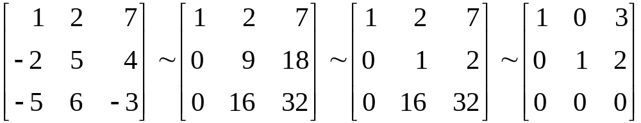


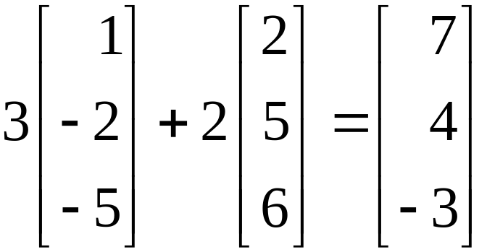
LINEAR COMBINATIONS
To solve this system, row reduce the augmented matrix of the system as follows.
The solution of (3) is and . Hence b is a linear combination of a₁ and a₂, with weights and
. That is,
.

Slide 14
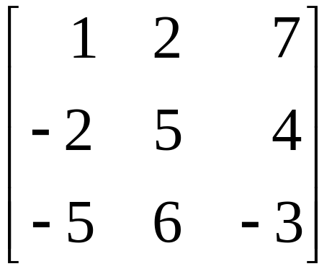
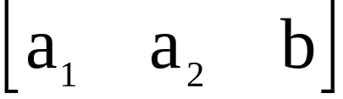
LINEAR COMBINATIONS
Now, observe that the original vectors a₁, a₂, and b are the columns of the augmented matrix that we row reduced:
Write this matrix in a way that identifies its columns.
----(4)
a₁
a₂
b

Slide 15
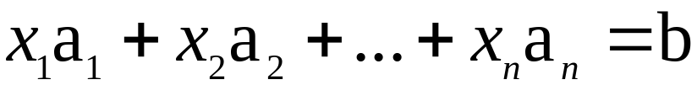
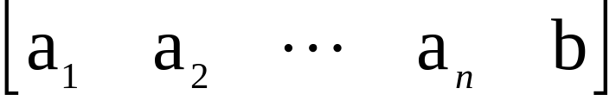
LINEAR COMBINATIONS
A vector equation
has the same solution set as the linear system whose augmented matrix is
. ----(5)
In particular, b can be generated by a linear combination of a₁, …, a_{n} if and only if there exists a solution to the linear system corresponding to the matrix (5).

Slide 16
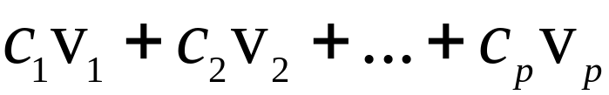
LINEAR COMBINATIONS
Definition: If v₁, …, v_{p} are in , then the set of all linear combinations of v₁, …, v_{p} is denoted by Span {v₁, …, v_{p}} and is called the subset of spanned (or generated) by v₁, …, v_{p}. That is, Span {v₁, ..., v_{p}} is the collection of all vectors that can be written in the form
with c₁, …, c_{p} scalars.

Slide 17
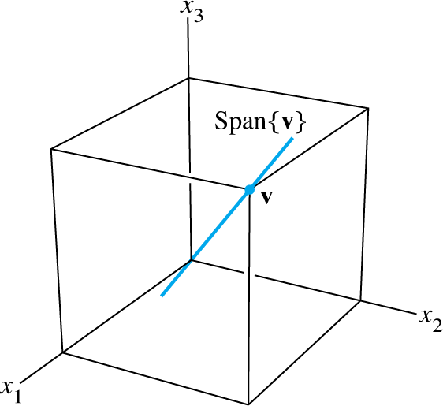
A GEOMETRIC DESCRIPTION OF SPAN {V}
Let v be a nonzero vector in . Then Span {v} is the set of all scalar multiples of v, which is the set of points on the line in through v and 0. See the figure below.

Slide 18
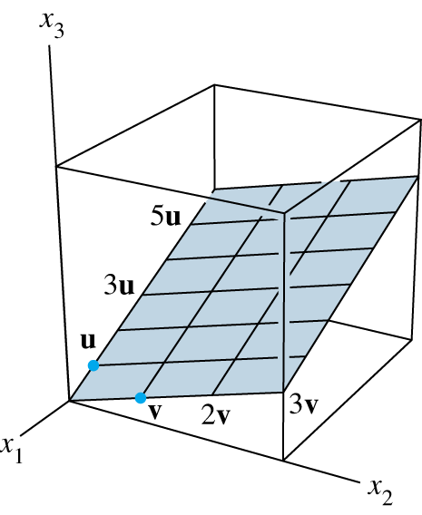
A GEOMETRIC DESCRIPTION OF SPAN {U, V}
If u and v are nonzero vectors in , with v not a multiple of u, then Span {u, v} is the plane in that contains u, v, and 0.
In particular, Span {u, v} contains the line in through u and 0 and the line through v and 0. See the figure below.

